Slide 1
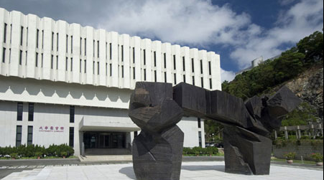

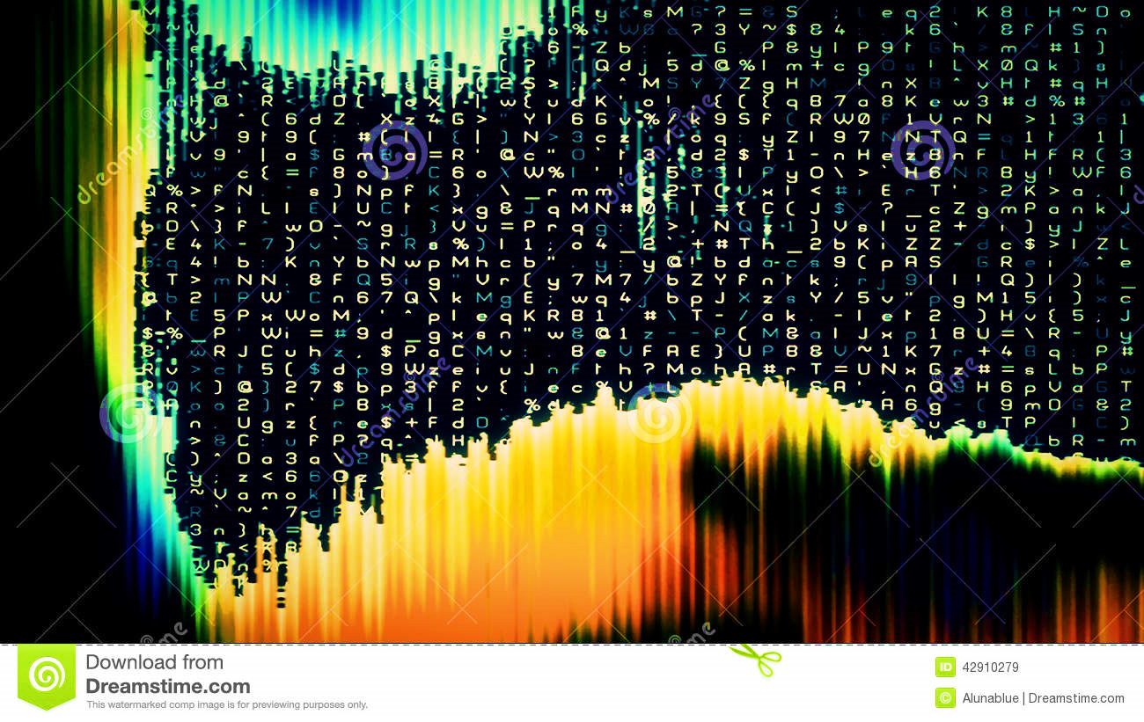


符号执行安全的代码混淆技术
报告人：徐辉
导 师：吕荣聪教授

Slide 2

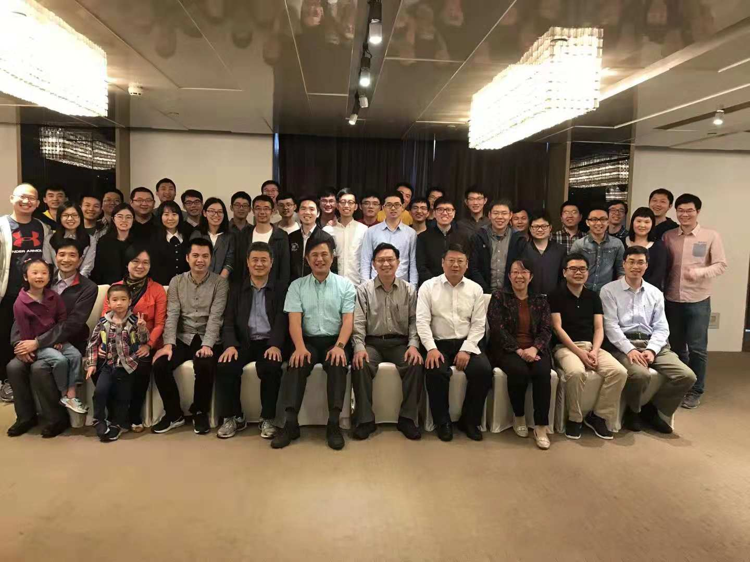



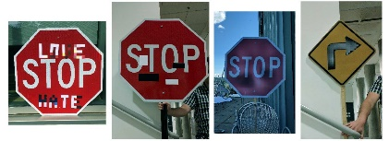
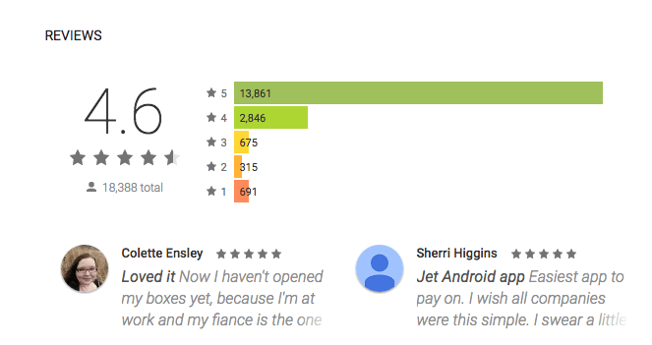
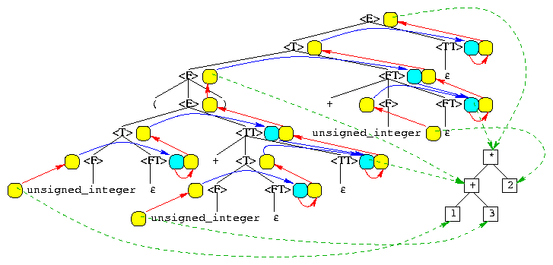
实验室简介
软件安全性
Software Engineering
日志分析
可靠AI软件
自然语言处理
用AI进行程序分析

Slide 3

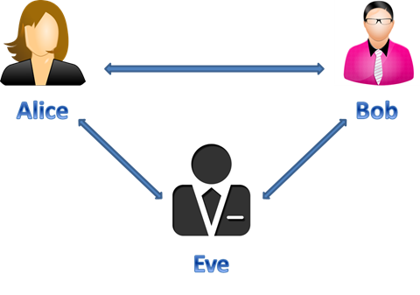



MATE（Man-At-The-End) 攻击
逆向工程
篡改软件
篡改消息
hostile host model
中间人攻击
MATE （端侧）攻击
“These attacks involve an adversary gaining an advantage by violating software or hardware under their control, directly or via a remote connection.”
- Christian Collberg
[Collberg’11] C. Collberg, et al. Toward digital asset protection. IEEE Intelligent Systems, 2011.

Slide 4
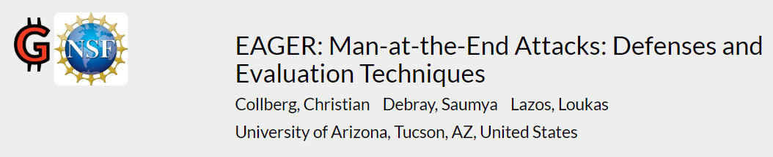
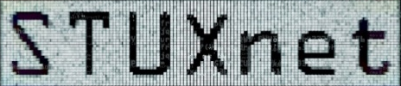
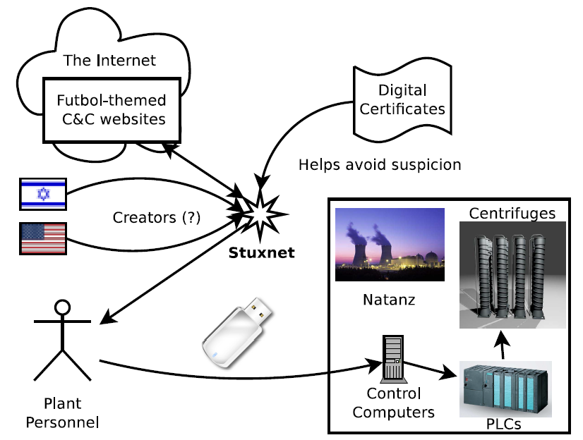
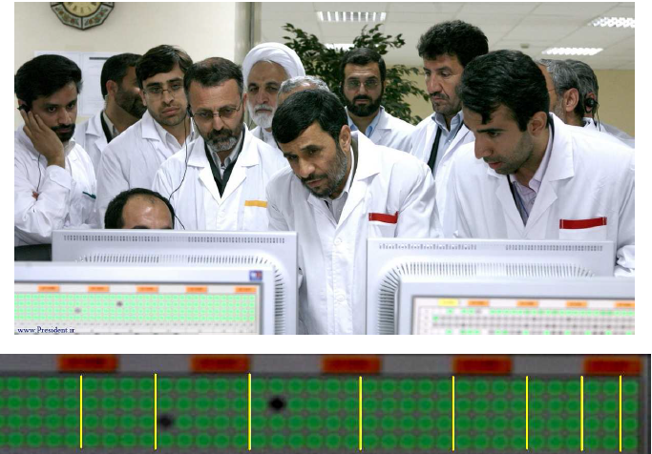

MATE攻击研究尚处于起步阶段
利用7个0日漏洞：5个针对Windows，2个针对西门子SIMATIC WinCC系统。
程序中出现了与离心机数量一致的数组：
16,20,24,20,16,12,8,4
[Mueller’12] Paul Mueller and Babak Yadegari. The Stuxnet Worm, 2012.

Slide 5

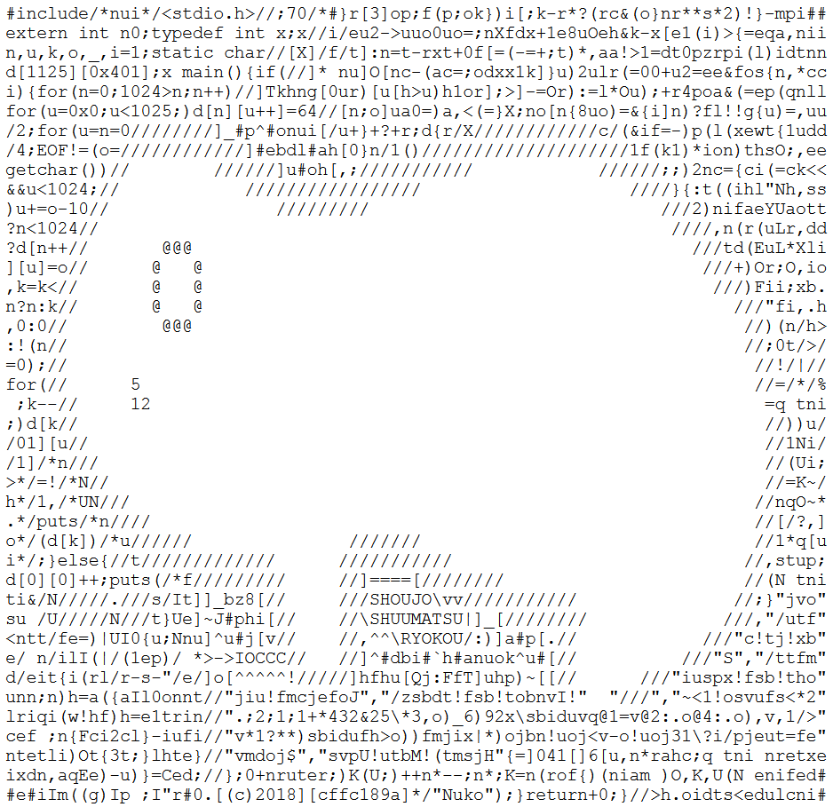
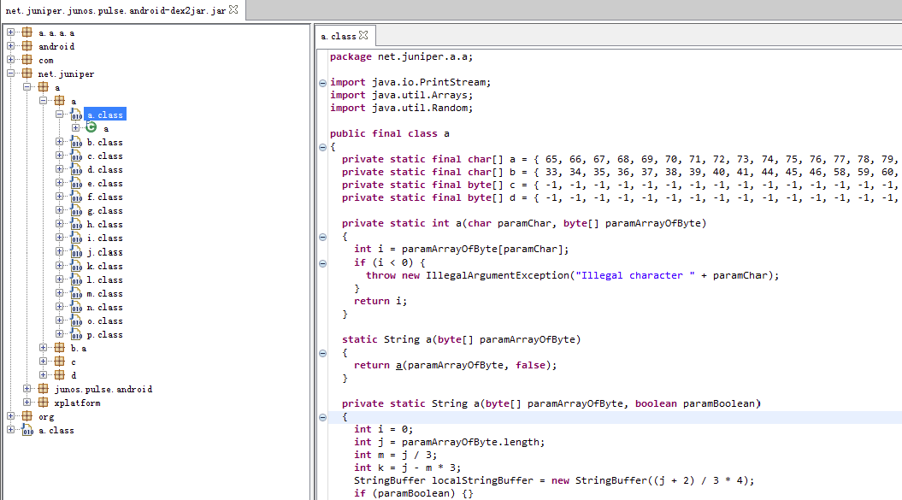
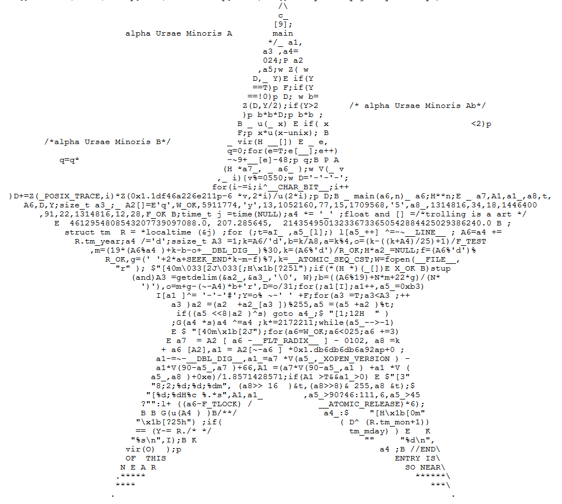
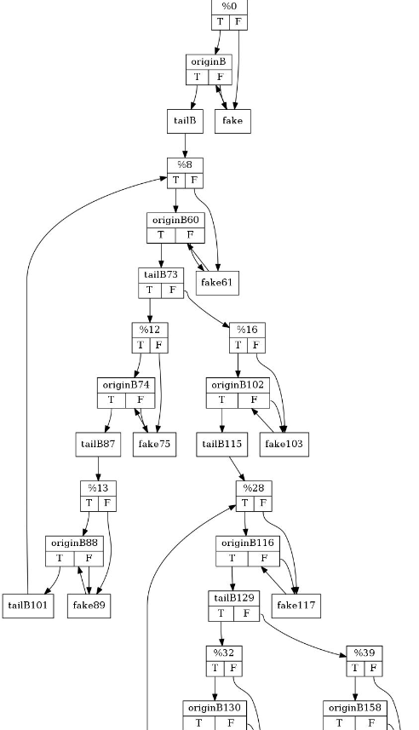
软件保护技术：代码混淆
将代码转换为另外一个版本：
难以阅读理解
语义不变
低性能代价
1984
https://www.ioccc.org/
Software Obfuscation
Code-Element Layer
Software-Component
Layer
Cross-Component Layer
Application Layer
Obfuscating Layout
Obfuscating Data
Obfuscating Controls
…
控制流混淆
Android App 混淆

Slide 6
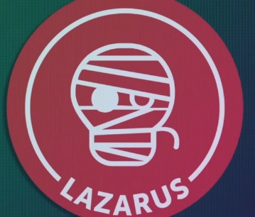
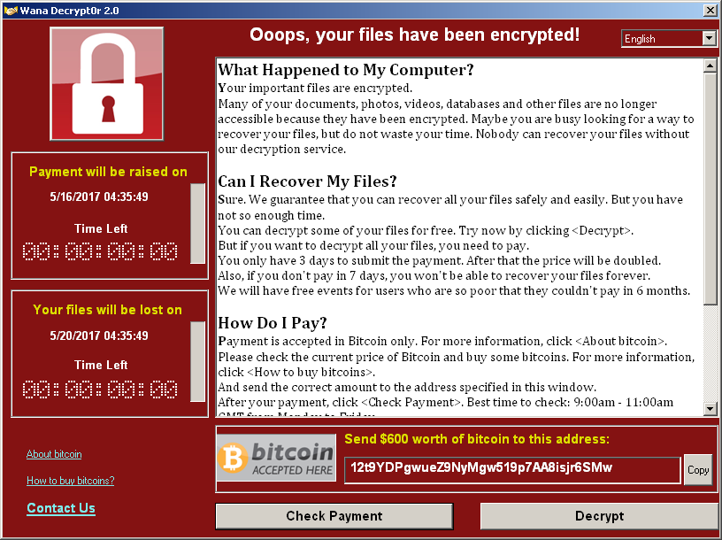
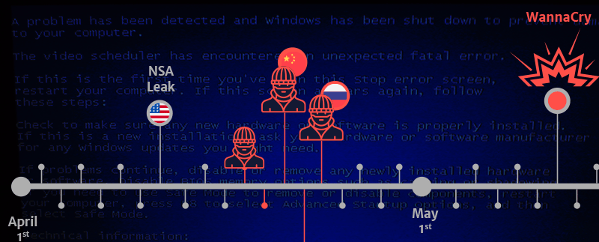
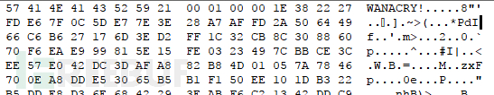
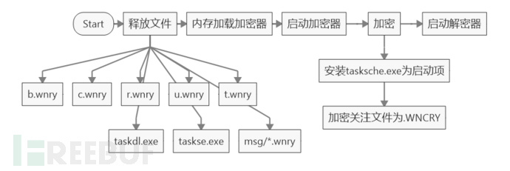
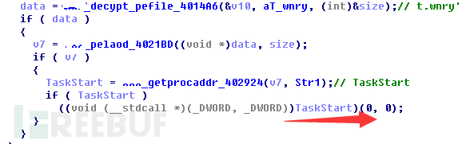
恶意用途：加壳
Eternal Blue: CVE-2017-0144
t.wnry
http://www.freebuf.com/column/135722.html

Slide 7
符号执行用于代码逆混淆
论文 | 标题 | SE工具
Guillot’2010 | Automatic binary deobfuscation | N/A
Ming’2015 | LOOP: Logic-oriented opaque predicate detection in obfuscated binary code | BAP
Yadegari’2015a | A generic approach to automatic deobfuscation of executable code | N/A
Yadegari’2015b | Symbolic execution of obfuscated code | N/A
Banescu’2015 | A framework for measuring software obfuscation resilience against automated attacks | KLEE
Xu’2017 | Cryptographic function detection in obfuscated binaries via bit-precise symbolic loop mapping | BAP
Bardin’2017 | Backward-bounded dse: Targeting infeasibility questions on obfuscated codes | BINSEC/SE
David’2017 | Formal approaches for automatic deobfuscation and reverse-engineering of protected codes | BINSEC/SE
Xu’2018 | Vmhunt: A verifiable approach to partially-virtualized binary code simplification | BAP

Slide 8
安全问题举例1：Crackme
CTF 题目: https://github.com/angr/angr-doc/tree/master/examples/fauxware
char *sneaky = "SOSNEAKY";
int authenticate(char *username, char *password)
{
char stored_pw[9];
stored_pw[8] = 0;
int pwfile;
if (strcmp(password, sneaky) == 0) return 1;
pwfile = open(username, O_RDONLY);
read(pwfile, stored_pw, 8);
if (strcmp(password, stored_pw) == 0) return 1;
return 0;
}
angr破解用了1.669 秒
使用Obfuscator-LLVM混淆后，angr仍然在1.737秒破解正确
* Intel(R) Core(TM) i7-8086K CPU @ 4.00GHz, 16GB DDR4 RAM, Debian Stretch; angr version: 8.18.10.25
* OLLVM version: 3.6.1

Slide 9
安全问题举例2：Opaque Predicate
Obfuscator-LLVM [Junod’15]
LLVM IR Code:
Source Code:
1
2
3
4
5
6
7
8
9
10
11
12
13
@x7 = common global i32 0
@y8 = common global i32 0
…
define i32 @main() #0 {
%1 = load i32* @x7
%2 = load i32* @y8
%3 = sub i32 %1, 1
%4 = mul i32 %1, %3
%5 = urem i32 %4, 2
%6 = icmp eq i32 %5, 0
%7 = icmp slt i32 %2, 10
%8 = or i1 %6, %7
br i1 %8, label %originalBB, label %originalBBalteredBB
int x7 = 0;
int y8 = 0;
恒真
if(x7(x7 – 1)%2 == 0||y8<10){
originalBB;
} else {
originalBBalteredBB;
}
[ollvm’15] Junod, et al. “Obfuscator-LLVM--software protection for the masses.” 2015

Slide 10
符号执行的破解原理
控制流遍历和解约束
int toy_func(int i){
if(i > 100){
return -1;
}
if(i *(i+1)%2!=0) {
Bogus();
}
return 0;
}
Entry:
if(i > 100)
opaque predicate
T
F
Control-flow Graph
return -1;
if(i*(i+1)%2!=0)
T
F
Bogus();
Return 0;
Round1:
Random Input:
i = 1000
Round 2:
Constraint: NOT (i > 100)
=> i = 0
Round 3:
Constraint: NOT(i > 100) AND i*(i+1)%2!=0
=> No Solution
Entry:
if(i > 100)
Entry:
if(i > 100)
T
F
T
return -1;
if(i*(i+1)%2!=0)
return -1;
F
Return 0;
[Ming’15] Ming, et al. "Loop: Logic-oriented opaque predicate detection in obfuscated binary code." CCS’15.

Slide 11
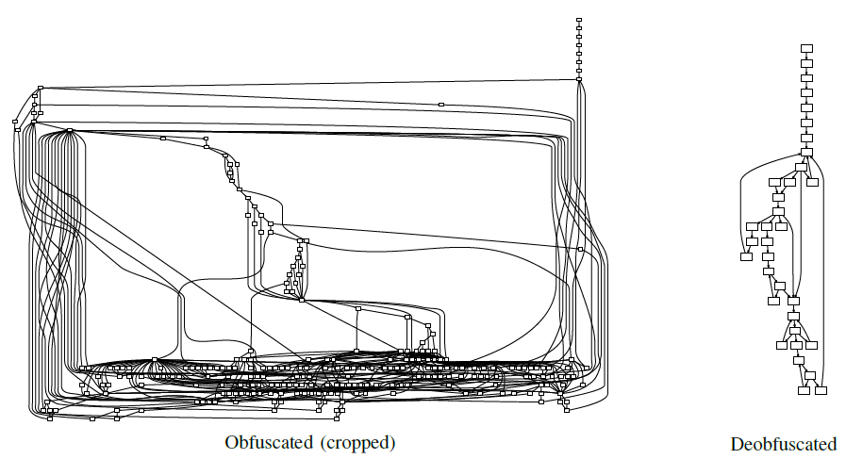
安全问题举例3：Switch-Case 控制流简化
Static Code:
Execution Trace:
Simplified Trace:
T:
0x500000
0x520000
0x550000
mov ebx, 0
mov eax, T[ebx]
jmp [eax]
Trace of code at 0x500000
add ebx, 4
cmp ebx, 12
jne L
mov eax, T[ebx]
jmp [eax]
Trace of code at 0x520000
add ebx, 4
cmp ebx, 12
jne L
mov eax, T[ebx]
jmp [eax]
Trace of code at 0x550000
add ebx, 4
cmp ebx, 12
jne L
jmp 0x500000
Trace of code at 0x500000
jmp 0x520000
Trace of code at 0x500000
jmp 0x550000
Trace of code at 0x500000
mov ebx, 0
mov eax, T[ebx]
jmp [eax]
add ebx, 4
cmp ebx, 12
jne L
L:
Control-flow Flattening
Simplification
[Yadegari’15] Yadegari, et al. "A generic approach to automatic deobfuscation of executable code." S&P’ 15.

Slide 12
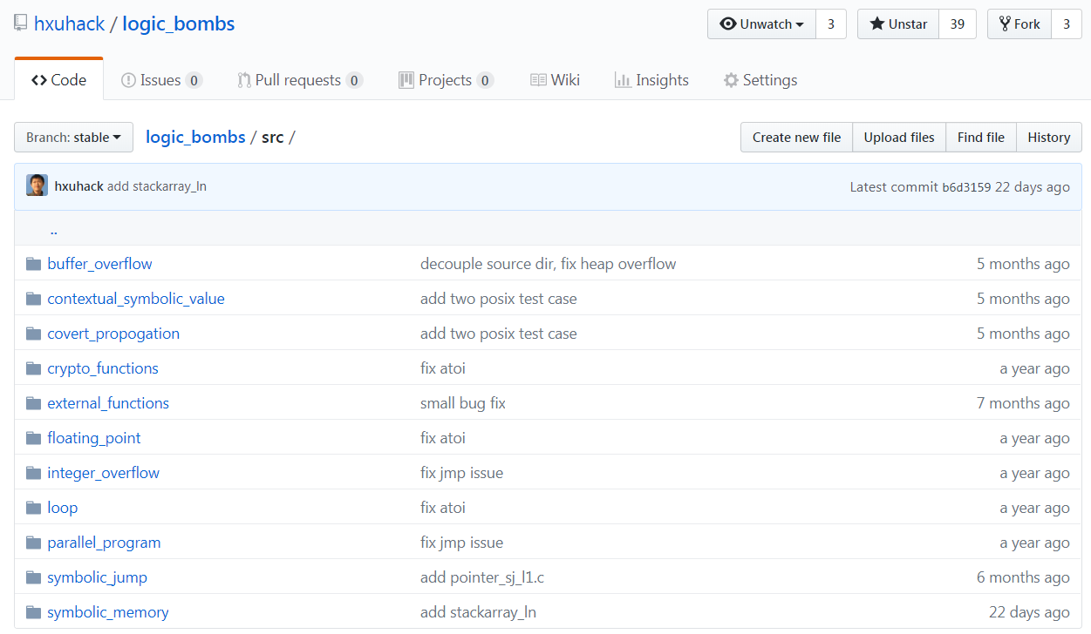



思路：利用符号执行的弱点进行代码混淆
Developed at Stanford (2008)
https://klee.github.io/
angr
Developed at UCSB (2016)
http://angr.io/
Developed at Quarkslab (2015)
https:// triton.quarkslab.com

Slide 13
测试用例Symbolic Memories
int logic_bomb(char* s) {
int i = s[0] - 48;
int j = abs(i%11);
int a[] = {(i+5)%11,(i+6)%11,(i+7)%11,(i+8)%11,(i+9)%11,(i+10)%11,
i%11,(i+1)%11,(i+2)%11,(i+3)%11,(i+4)%11};
int* p = &a[a[a[j]]];
int* q = &a[a[a[a[a[*p]]]]];
if(p == q){
return BOMB_ENDING;
}
else
return NORMAL_ENDING;
}
指针分析问题
符号执行工具是否可以找到执行BOMB_ENDING的测试用例？

Slide 14
测试结果
问题 |  | 结果 (通过 #/ 总数 #)
 |  | KLEE | Triton | Angr
Symbolic-Reasoning Challenges | Symbolic Variable Declaration | 0/7 | 0/7 | 0/7
 | Covert Propagations | 1/5 | 1/9 | 4/9
 | Buffer Overflows | 0/4 | 0/4 | 2/4
 | Parallel Executions | 0/5 | 0/5 | 0/5
 | Symbolic Memories | 5/6 | 0/8 | 7/8
 | Contextual Symbolic Values | 0/7 | 0/7 | 0/7
 | Symbolic Jumps | 1/1 | 0/4 | 2/4
 | Floating-Point Numbers | 0/5 | 0/5 | 2/5
 | Arithmetic Overflows | 2/2 | 1/2 | 2/2
Path-Explosion Challenges | Loops | 0/5 | 0/5 | 0/5
 | Crypto Functions | 0/2 | 0/2 | 0/2
 | External Function Calls | 0/8 | 1/8 | 3/8
总数 |  | 9/54 | 3/63 | 22/63
[Hui’18] Hui Xu, Zirui Zhao, Yangfan Zhou, and Michael R. Lyu, “Benchmarking the Capability of Symbolic Execution Tools,” TDSC, 2018.

Slide 15



混淆工具Fusor
基于源代码的混淆工具，以LLVM Pass的方式运行
主要用户群体是程序员，在编译代码的时候调用
混淆的作用是抵御逆向工程，目的是保护软件知识产权
LLVM编译器
输入
中间代码
输出
前端
后端
源代码
Fusor
可执行代码

Slide 16
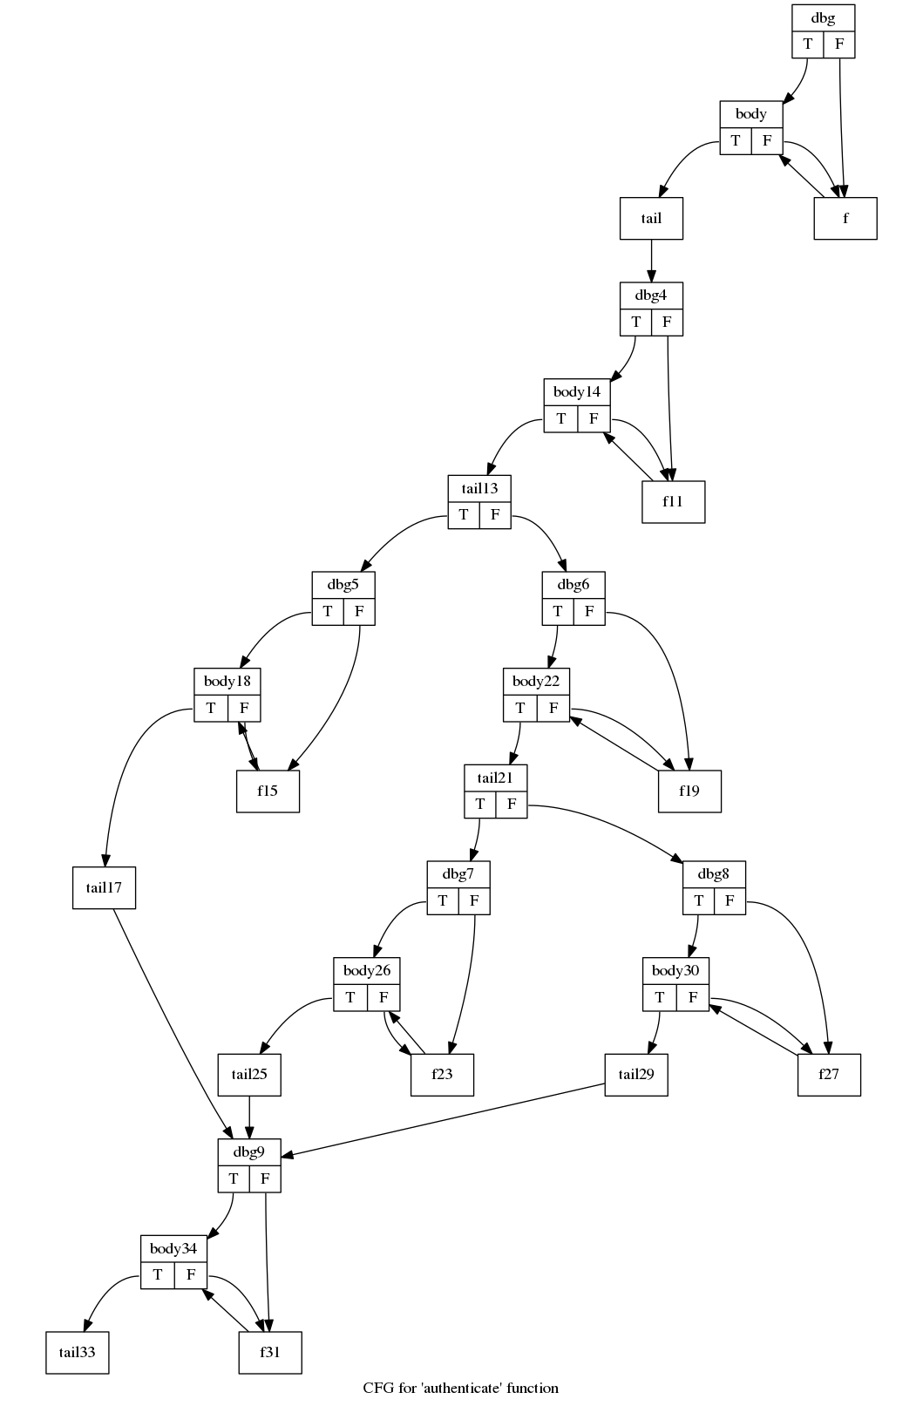
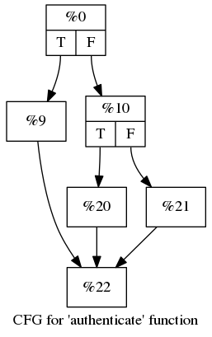
安全效果
前面的CFT问题angr在4.3秒后给出了错误答案
angr的错误输出: SK
正确结果: SOSNEAKY
Fusor混淆

Slide 17
性能：空间效率
空间效率高于Obfuscator-LLVM

Slide 18
性能：运行效率
运行效率优于Obfuscator-LLVM

Slide 19
博士期间工作汇总
报告内容
符号执行安全的代码混淆
持续认证
端侧软件保护
N版本代码混淆
代码混淆
安卓安全
隐私泄露
深度学习模型混淆

Slide 20
相关论文成果
[1] “Benchmarking the Capability of Symbolic Execution Tools with Logic Bombs,” Hui Xu, Zirui Zhao, Yangfan Zhou, and Michael R. Lyu, in Transactions on Dependable and Secure Computing (TDSC), 2018.
[2] “Manufacturing Resilient Bi-Opaque Predicates against Symbolic Execution,” Hui Xu, Yangfan Zhou, Yu Kang, Fengzhi Tu and Michael R. Lyu, in Proceedings of the 48th IEEE/IFIP International Conference on Dependable Systems and Networks (DSN), Luxembourg, 2018.
[3] “Concolic Execution on Small-Size Binary Codes: Challenges and Empirical Study,” Hui Xu, Yangfan Zhou, Yu Kang, and Michael R. Lyu, in Proceedings of the 47th IEEE/IFIP International Conference on Dependable Systems and Networks (DSN), Denver, USA, 2017.
[4] “IntelliAd: Assisting Mobile App Developers in Measuring Ad Costs Automatically [Poster],” Cuiyun Gao, Yichuan Man, Hui Xu, Jieming Zhu, Yangfan Zhou and Michael R. Lyu, in Proceedings of the 39th International Conference on Software Engineering (ICSE-C), Buenos Aires, Argentina, 2017.
[5] “Assessing the Security Properties of Software Obfuscation,” Hui Xu, and Michael R. Lyu, in IEEE Security and Privacy, Oct, 2016.

Slide 21
相关论文成果
[6] “N-Version Obfuscation,” Hui Xu, Yangfan Zhou, and Michael R. Lyu, (invited keynote paper) in Proceedings of the 2nd Cyber-Phsical System Security Workshop (in conjunction with AsiaCCS), Xi’an, China, 2016.
[7] “DiagDroid: Android Performance Diagnosis via Anatomizing Asynchronous Executions,” Yu Kang, Yangfan Zhou, Hui Xu, and Michael R. Lyu, in Proceedings of the 24th ACM SIGSOFT International Symposium on the Foundations of Software Engineering (FSE), Seattle, USA ,2016.
[8] “SpyAware: Investigating the Privacy Leakage Signatures in App Execution Traces,” Hui Xu, Yangfan Zhou, Cuiyun Gao, Yu Kang, Michael R. Lyu, in Proceedings of the 26th IEEE International Symposium on Software Reliability Engineering (ISSRE), Washington DC, USA, 2015.
[9] “AR-Tracker: Track the Dynamics of Mobile Apps via User Review Mining,” Cuiyun Gao, Hui Xu, Junjie Hu, and Yangfan Zhou, in Proceedings of the 2015 IEEE Symposium on Service-Oriented System Engineering (SOSE), San Francisco, USA, 2015.
[10] “Towards Continuous and Passive Authentication via Touch Biometrics: An Experimental Study on Smartphones,” Hui Xu, Yangfan Zhou, and Michael R. Lyu, in Proceedings of the USENIX Symposium on Usable Privacy and Security (SOUPS), San Francisco, USA, 2014.

Slide 22
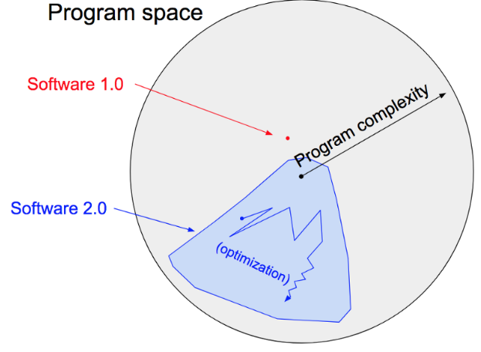
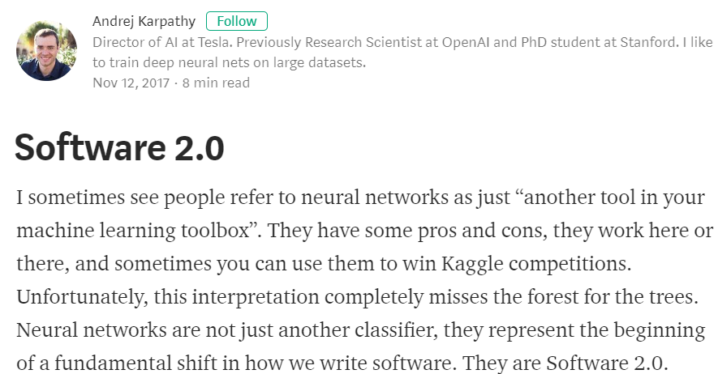
未来研究方向
传统软件
软件2.0
MATE攻击
软件保护
https://medium.com/@karpathy/software-2-0-a64152b37c35

Slide 23
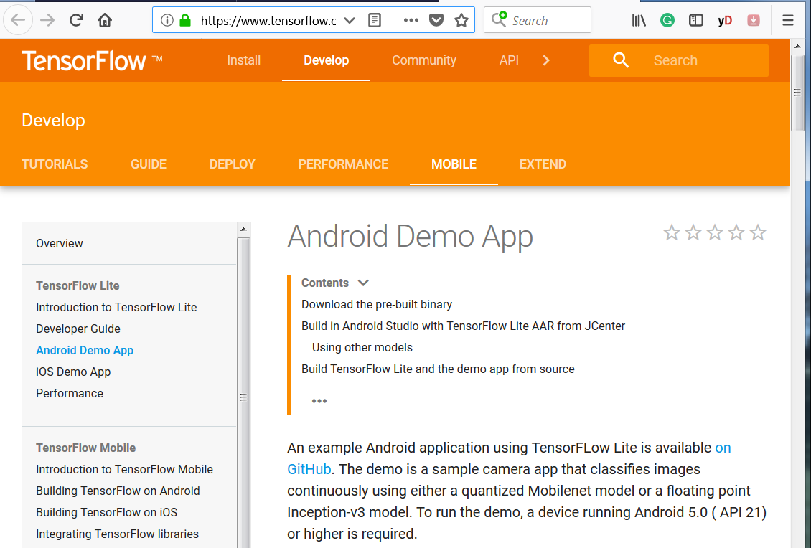
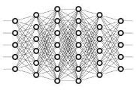



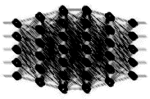
深度学习软件的知识产权保护问题
软件发布
开发者
逆向
客户端
盗版
结构窃取
参数窃取
盗版模型
攻击者
Transfer Learning Experiment
(CIFAR-10 to STL10)
Incremental Learning Experiment
(CIFAR-10 to CIFAR-100)
Transfer Learning(77.94%)
Incremental Learning (67.95%)
ResNet (58.67%)
GoogLeNet (58.49%)

Slide 24


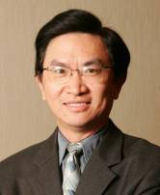


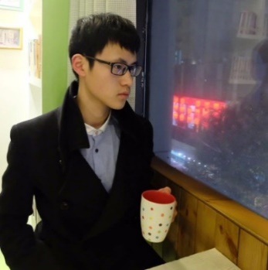



致谢
Asso. Prof. Yangfan Zhou
Dr. Yu Kang
Prof. Michael Lyu
Dr. Cuiyun Gao
Yuxin Su
Zirui Zhao

